Slide 2




Mining the Data – API – Driven Extraction
PLATFORM
RAW
DATA
API

Slide 3
Feature Engineering
Before
After
Total Wishlists: 5000…………………
Sentiment: Positive
7 – Day Wishlist Velocity: +15000
Sentiment Trend: + 0.8
Devoloper Reputation Score: 8.2 / 10

Slide 4
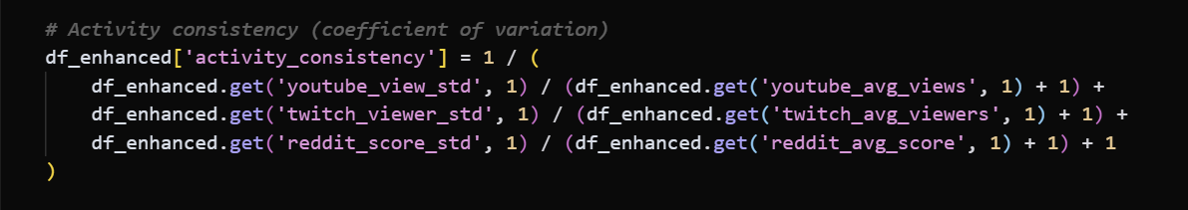
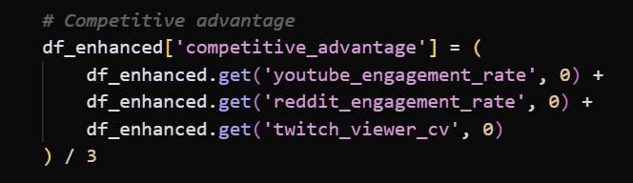
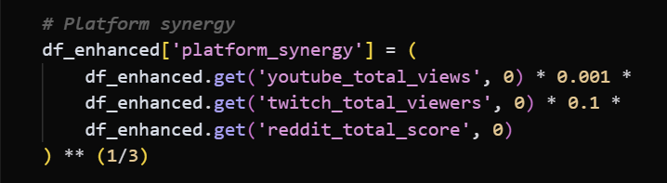
Code in Action

Slide 5
The Final Feature Set
Reddit | Steam | Twitch | Youtube
reddit_avg_score | steam_current_players | twitch_total_viewers | youtube_avg_likes
reddit_engagement_rate | steam_wishlist_count | twitch_unique_streamers | youtube_avg_comments
reddit_avg_sentiment | steam_metacritic | twitch_max_viewers | youtube_max_comments
reddit_total_commenters | steam_review_count | twitch_viewer_cv

Slide 6
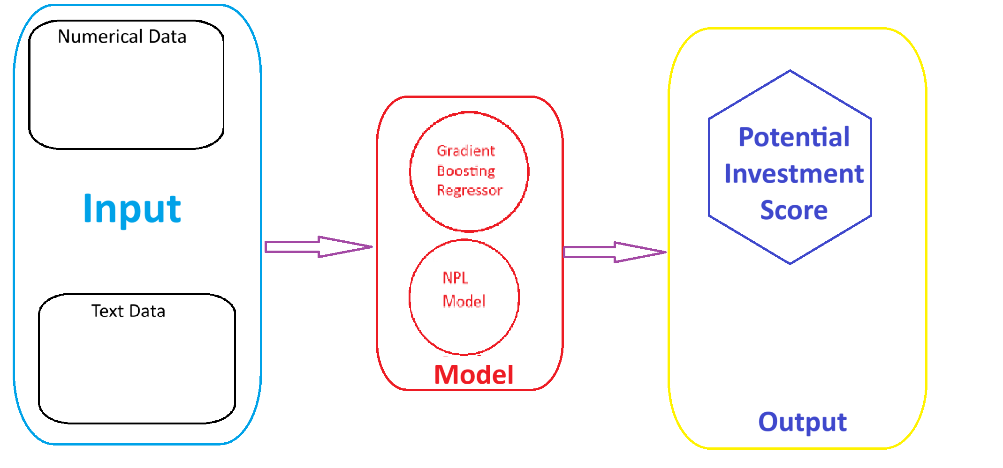
Hybird & Interpretable Model

Slide 7
From Predict to Actionable Intelligence

Slide 8
The Shape of Buzz Matters Most (insight)
可删

Slide 9
The Strategic Advantage: AI – Driven Marketing

Slide 10
Limitations

